Slide 1
Chapter 5. The Natural and Step Response of RL and RC Circuits(1)

Slide 2
Contents
Capacitor and Capacitance
Inductor and Inductance
Dynamic Element and Circuit
RC and RL Circuits
Switching Theorem

Slide 3
Goals
Know and use the VCR of capacitors
Know and use the VCR of inductors
Calculate the energy for capacitor and inductor
Capacitors and inductors in series and parallel
Ability to determine the initial values of circuits

Slide 4
Contents
Capacitor and Capacitance
Inductor and Inductance
Dynamic Element and Circuit
RC and RL Circuits
Switching Theorem

Slide 5
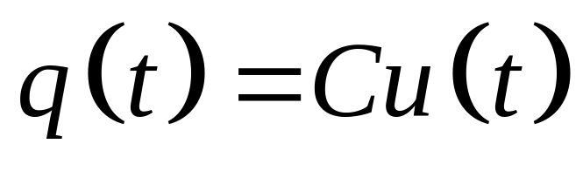
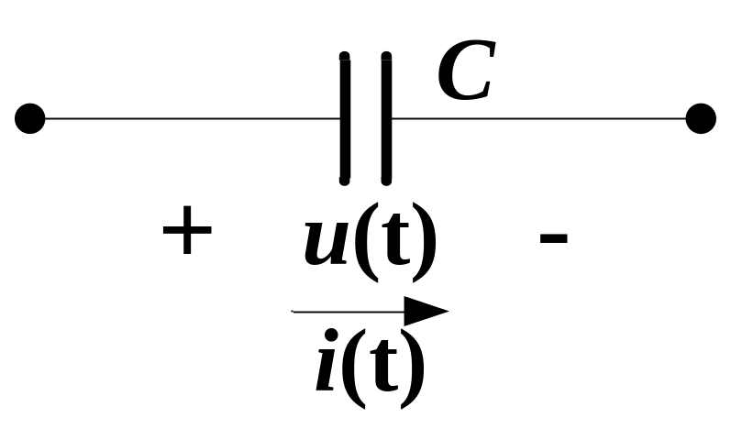
Capacitor and Capacitance
Capacitor is a charge storing device;
CVR of ideal capacitor:
Reference voltage and current defined with passive sign convention

Slide 6
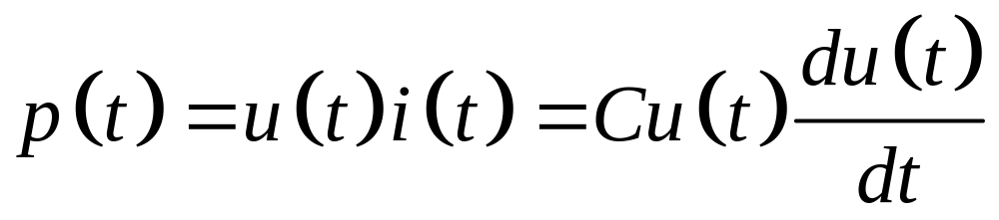
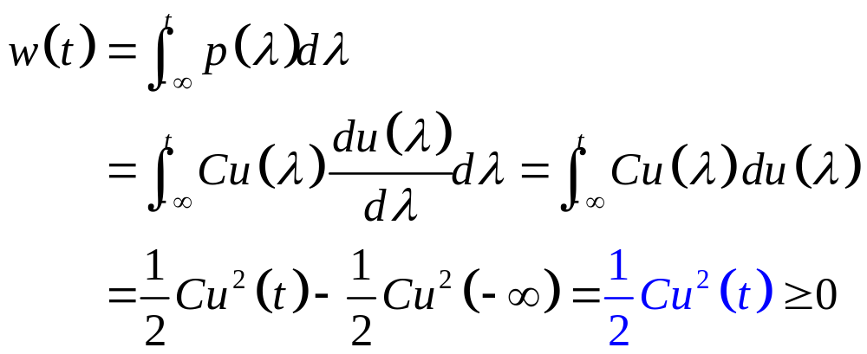
Power and Energy
Power:
Energy:

Slide 7
Contents
Capacitor and Capacitance
Inductor and Inductance
Dynamic Element and Circuit
RC and RL Circuits
Switching Theorem

Slide 8
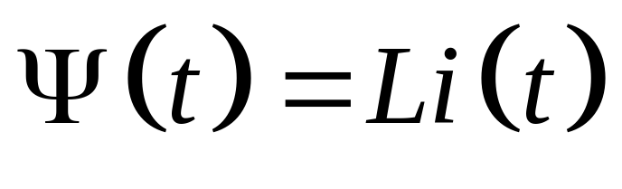
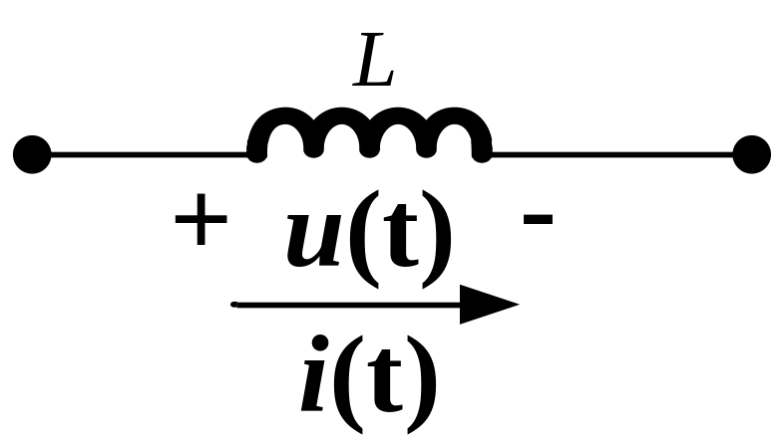
Inductor and Inductance
Inductor is a energy storing device;
WCR of ideal Inductor:
Reference voltage and current defined with passive sign convention

Slide 9
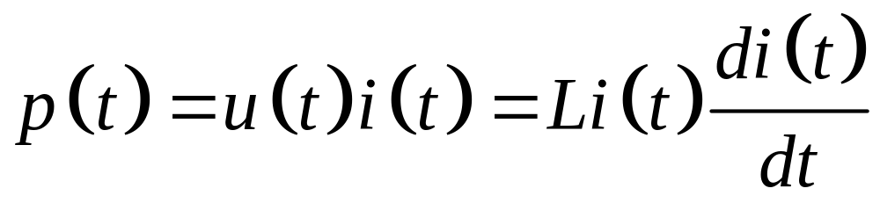
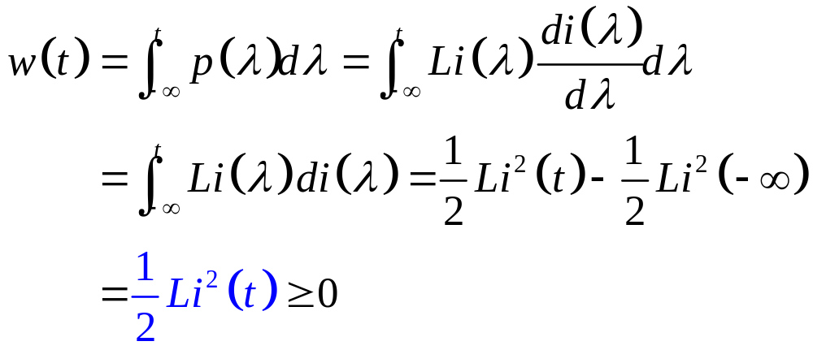
Power and Energy
Power:
Energy:

Slide 10
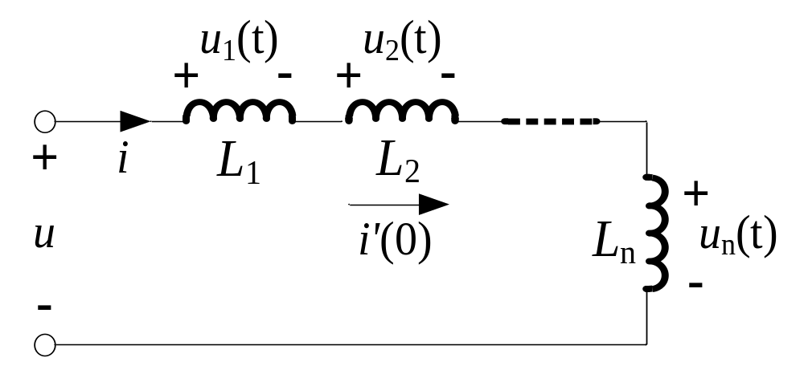
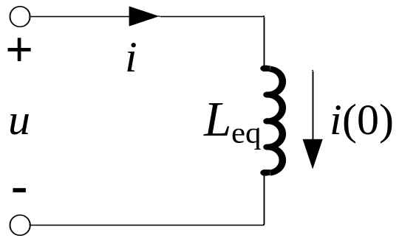
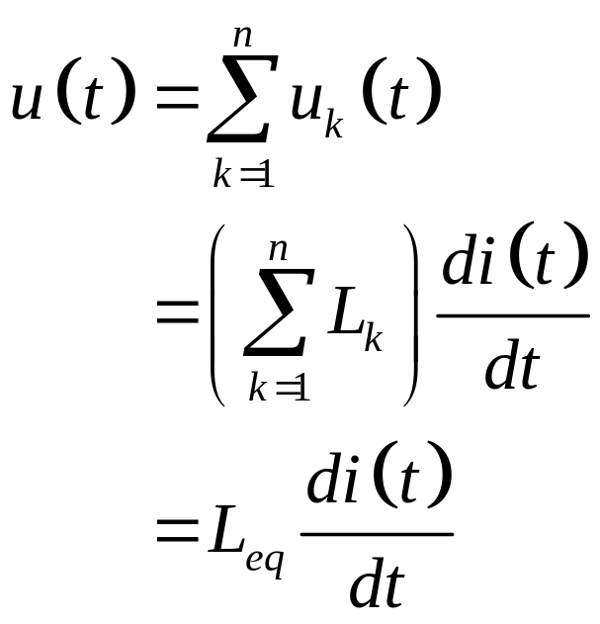
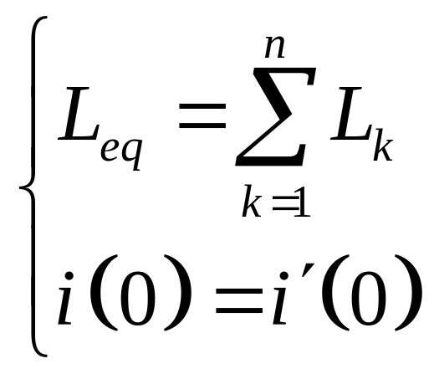
Inductors in Series

Slide 11
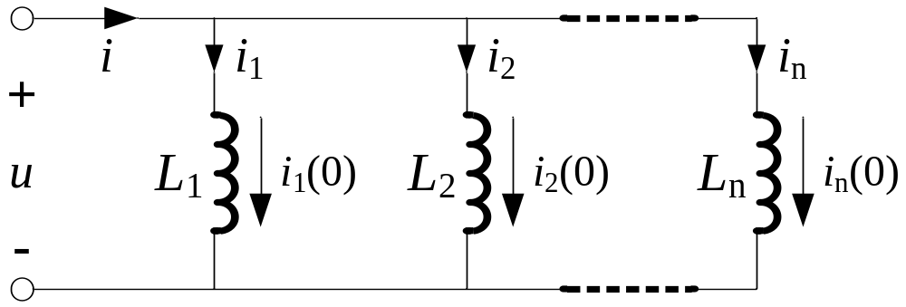
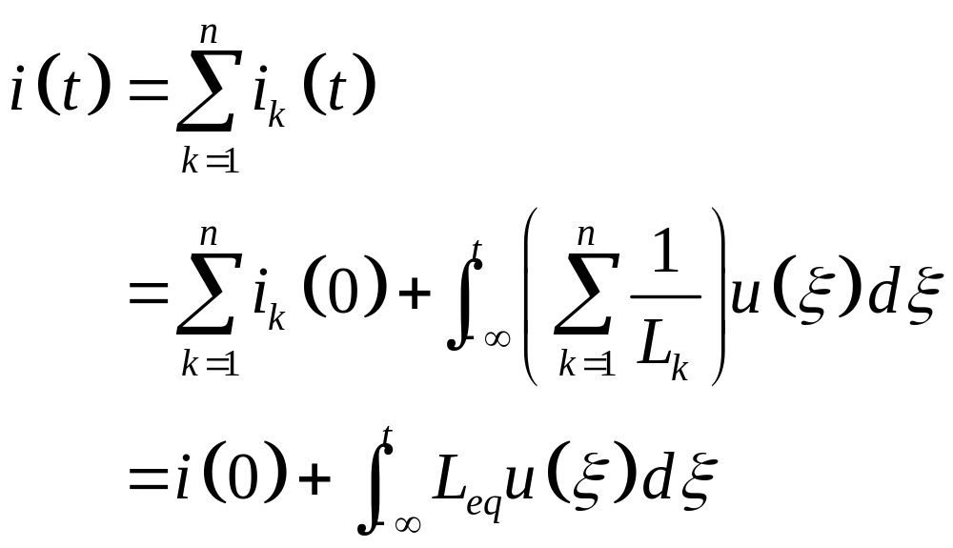
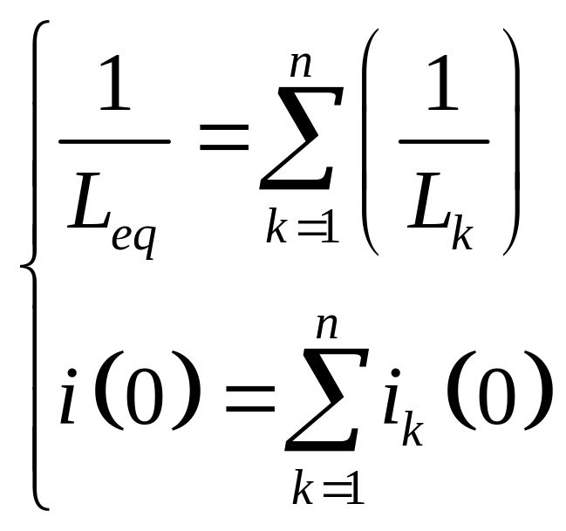
Inductors in Parallel

Slide 12
Contents
Capacitor and Capacitance
Inductor and Inductance
Dynamic Element and Circuit
RC and RL Circuits
Switching Theorem

Slide 13
Dynamic Element
Resistor:
  VCR of terminals is a linear algebraic equation;
  VCR is “instantaneous” or “memoryless”;
  Static element.

Slide 14
Dynamic Element
Capacitor and Inductor:
  VCR is a differential or integral equation;
  VCR is “historical” or “memorial”;
  Dynamic elements.

Slide 15
Contents
Capacitor and Capacitance
Inductor and Inductance
Dynamic Element and Circuit
RC and RL Circuits
Switching Theorem

Slide 16
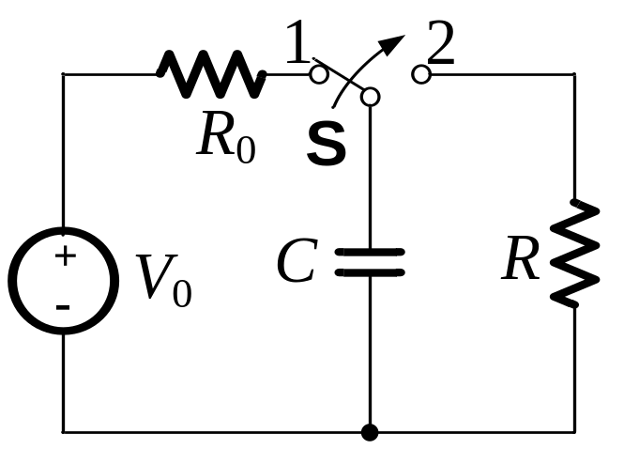
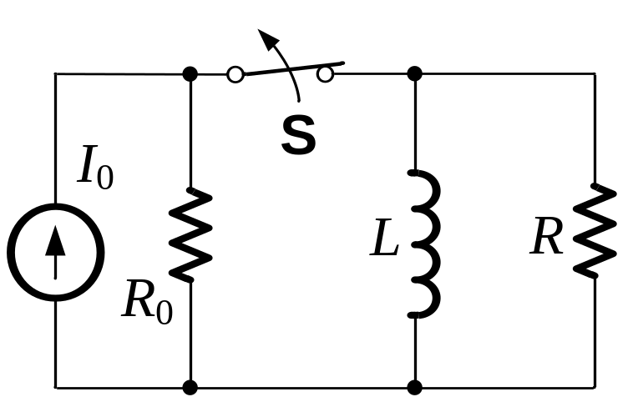
Natural Response
The capacitor/inductor is abruptly disconnected from its source;
Energy stored in the capacitor/inductor is released to a resistive network.

Slide 17
Contents
Capacitor and Capacitance
Inductor and Inductance
Dynamic Element and Circuit
RC and RL Circuits
Switching Theorem

Slide 18
Initial Values
Switching Time
Switching Theorem
Method for Initial Values

Slide 19
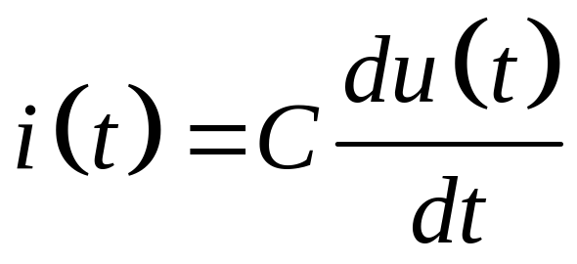
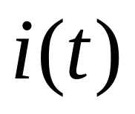
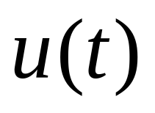
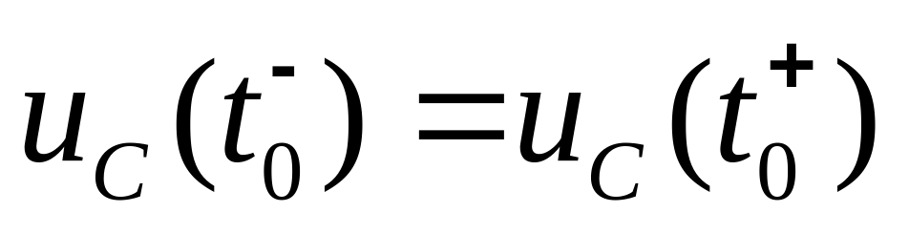
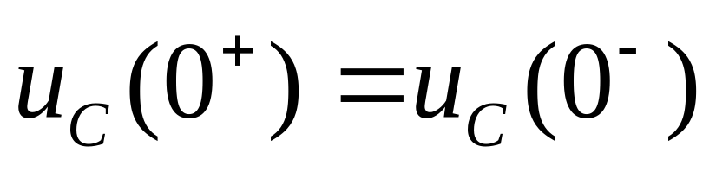
Switching Theorem
For a capacitor,
If
is limited, then
is continuous.
Specially, if t₀=0,

Slide 20
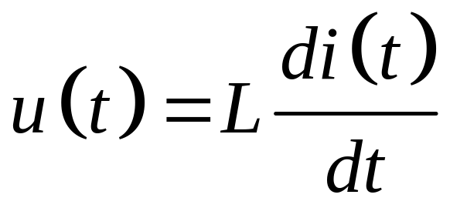
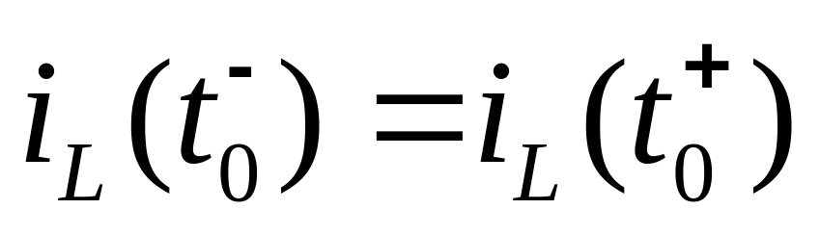
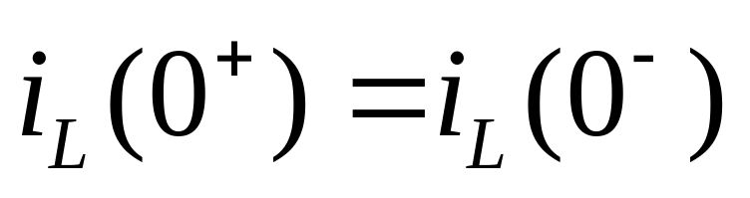
Switching Theorem
For a inductor,
If
is limited, then
is continuous.
Specially, if t₀=0,

